Slide 2
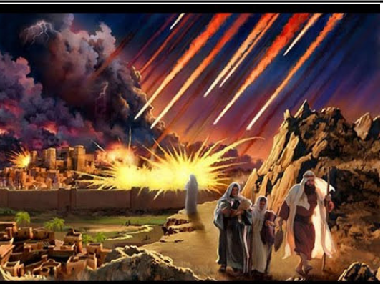
Title Layout
Subtitle

Slide 3
BEWARE OF COINT
Beware of COUNTERFEITS
False Apostles – 2 Corinthians 11:13-15
False Christians – Matthew 7:21
False Gospel – Galatians 1:6-8
False Righteousness – Romans 10:3
False Prophets – Jeremiah 6:13-16
False Teachers – 2 Peter 2:1-3
Micah 3:11
1 Thessalonians 2:5
2 Corinthians 4:2

Slide 4
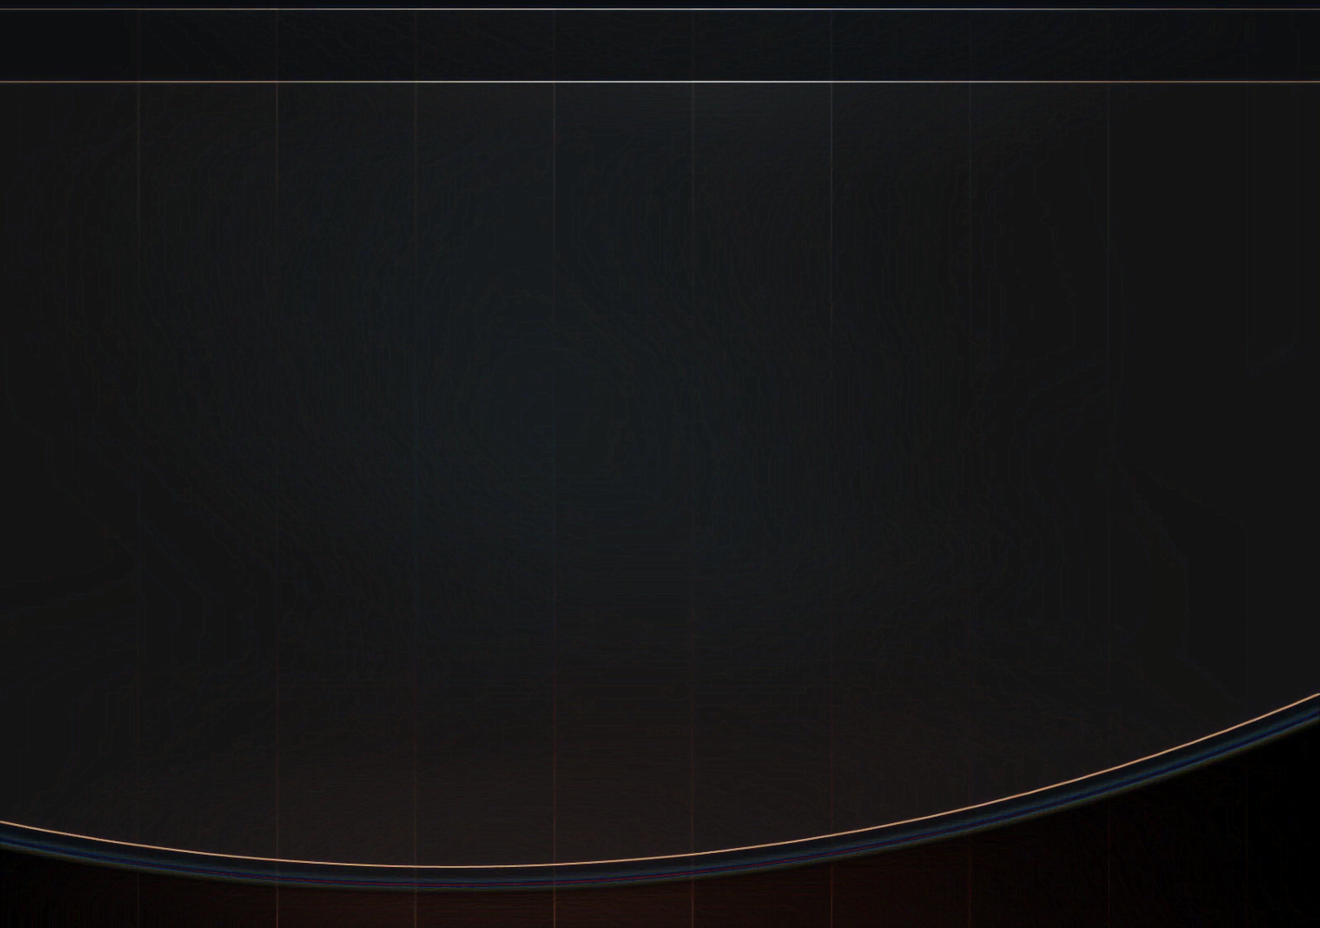
Notice Peter’s Picture in Verse 2:
V.2 “And many will follow their destructive ways, because of whom the way of truth will be blasphemed.”
V. 15 “They have forsaken the right way and gone astray, following the way of Balaam the son of Beor, who loved the wages of unrighteousness.”
V. 2 “the way of truth” and V. 15 “forsaking the right way”
Does this suggest that there are many roads to heaven?
2 Peter 2:20-22 “the way of righteousness”

Slide 5
Consequences
2 Peter 2:5 “and did not spare the ancient world, but saved Noah, one of eight people, a preacher of righteousness, bringing in the flood on the world of the ungodly;”
2 Peter 2:7,8 “and delivered righteous Lot, who was oppressed by the filthy conduct of the wicked 8 (for that righteous man, dwelling among them, tormented his righteous soul from day to day by seeing and hearing their lawless deeds).”

Slide 6
“What happens when a ‘righteous man’ makes wrong decisions?”

Slide 7
Review of History
Genesis 12:1-5 - “Abram departed as the Lord had spoken to him, and Lot went with him..”
Genesis 12:10 – “a famine in the land, and Abram went down to Egypt to dwell there…”
Genesis 13:1 – “Abram went up from Egypt, …, and Lot with him,..”
Genesis 13:2 – “Abram was very rich in livestock, in silver, and in gold”

Slide 8
Review of History
Genesis 12:7 - “he built an altar to the Lord”
Genesis 13:5 – “ Lot also, who went with Abram, had flocks and herds and tents…”
Genesis 13:6,7 – “their possessions were so great that they could not dwell together,..”
Genesis 13:8,9 – “you take the left, then I will go to the right,”

Slide 9
Review of History
Genesis 13:10-13 - “Abram dwelt in the land of Canaan, and Lot dwelt in the cities of the plain and pitched his tent even as far as Sodom…”
He LOOKED, DESIRED and CHOSE!
Sodom’s wicked environment was no secret!
Why would a father expose his family to such immorality?
Did he think they could live in it and maintain morality?

Slide 10
Review of History
1 Corinthians 15:33 NKJV 33 Do not be deceived: "Evil company corrupts good habits."
He had a chance to reconsider this after his family was taken captive and rescued by Abraham – Genesis 14:1-16

Slide 11
Let’s Examine His Decisions
Genesis 13:10 "Lifted his eyes and saw"
Genesis 13:13 “the men of Sodom were exceedingly wicked and sinful against the LORD.”
Bad decisions lead to a terrible dilemma- Genesis 19:6-8

Slide 12
Let’s Examine His Decisions
Faced with another dilemma – how his family regarded his opinion- Genesis 19:12,14 “to his sons-in-law he seemed to be joking.”
1 Corinthians 6:18 “flee sexual immorality”
James 4:4 “Do you not know that friendship with the world is enmity with God? Whoever therefore wants to be a friend of the world makes himself an enemy of God.”

Slide 13
Bad Decisions Dilute The Decision- Making Process
Events of Genesis Chapter 14 suggest it
Genesis 19:16 shows it “And while he lingered, the men took hold of his hand, his wife’s hand, and the hands of his two daughters, the Lord being merciful to him, and they brought him out and set him outside the city.”
“Lingered” – hesitated!

Slide 14
“REMEMBER LOT’S WIFE”
Luke 17:32
Genesis 19:26 “But his wife looked back behind him, and she became a pillar of salt.”
In the face of a clear warning from God, she still looked back!
Do we take as lightly God’s commands today?

Slide 15
Lot Made Bad Decisions & Lived In Torment
Lost Loved Ones/ Possessions- Genesis 19:25 “So He overthrew those cities, all the plain, all the inhabitants of the cities, and what grew on the ground.”
Lost his Freedom – Genesis 19:30 “for he was afraid to dwell in Zoar. And he and his two daughters dwelt in a cave.”
Lost his Morals – Genesis 19:32 “let us make our father drink wine, and we will lie with him”

Slide 16
WE NEED TO LEARN A LESSON FROM LOT
Consider how you are influenced by your surroundings, friends, conduct
It’s a mistake to make decisions solely for financial gain with no thought for the spiritual welfare of your family
Don’t live “vexed” or tormented in your soul; life is too short, eternity too long, and hell too hot to take any chances

